Slide 1
CS213 Recitation 5
Notes:
Hello, everyone. In today’s recitation, let’s go over some knowledge points about software testing and java collection.

Slide 2
Software testing
Java Collection
Notes:
These are the contents we will cover today.

Slide 3
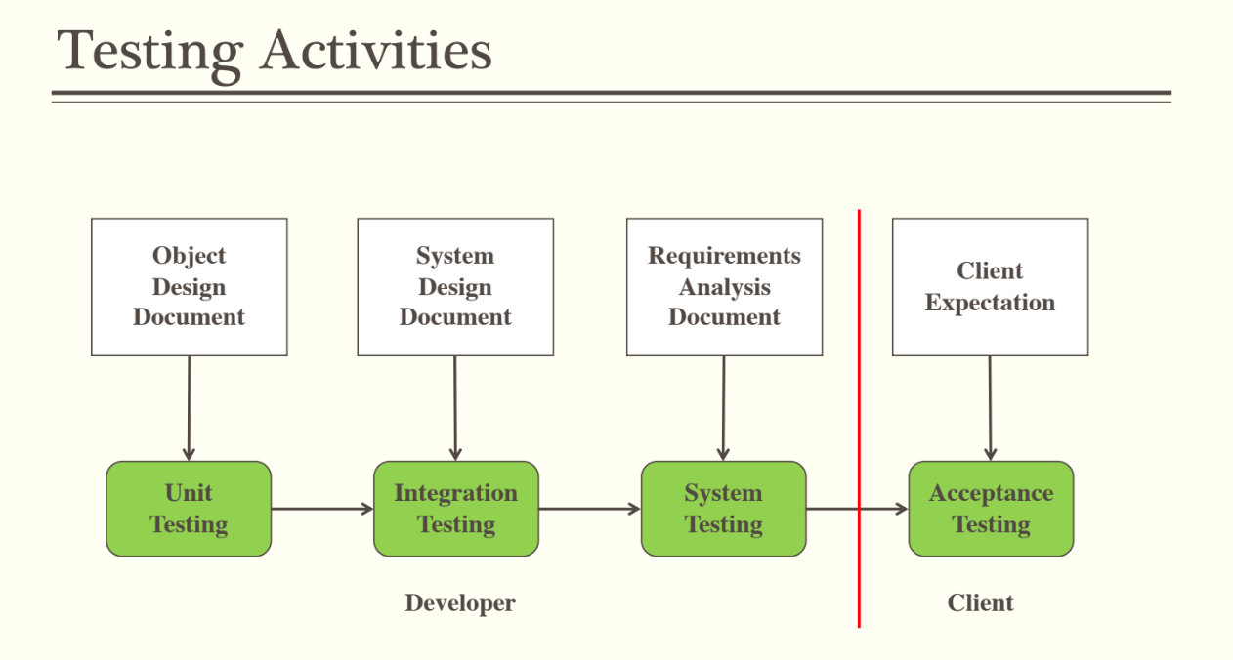
Software Testing
Notes:
We mainly have four types of testing. Unit testing, Integration testing , system testing and acceptance testing.

Slide 4
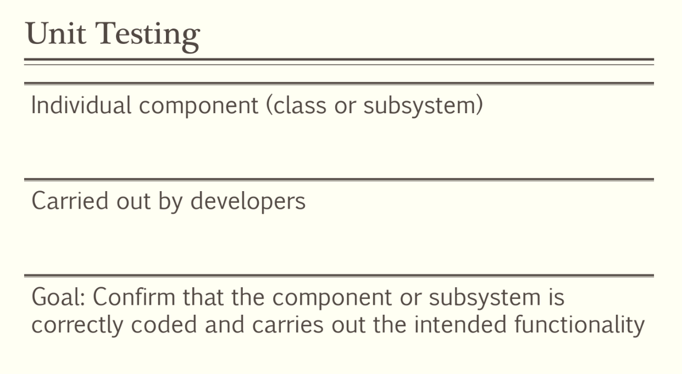
Notes:
We will mainly introduce Unit Testing. The goal of Unit Testing is to confirm that the component or subsystem is correctly coded and carries out the intended functionality. Unit testing is carried out by developers and its object is individual component.

Slide 5
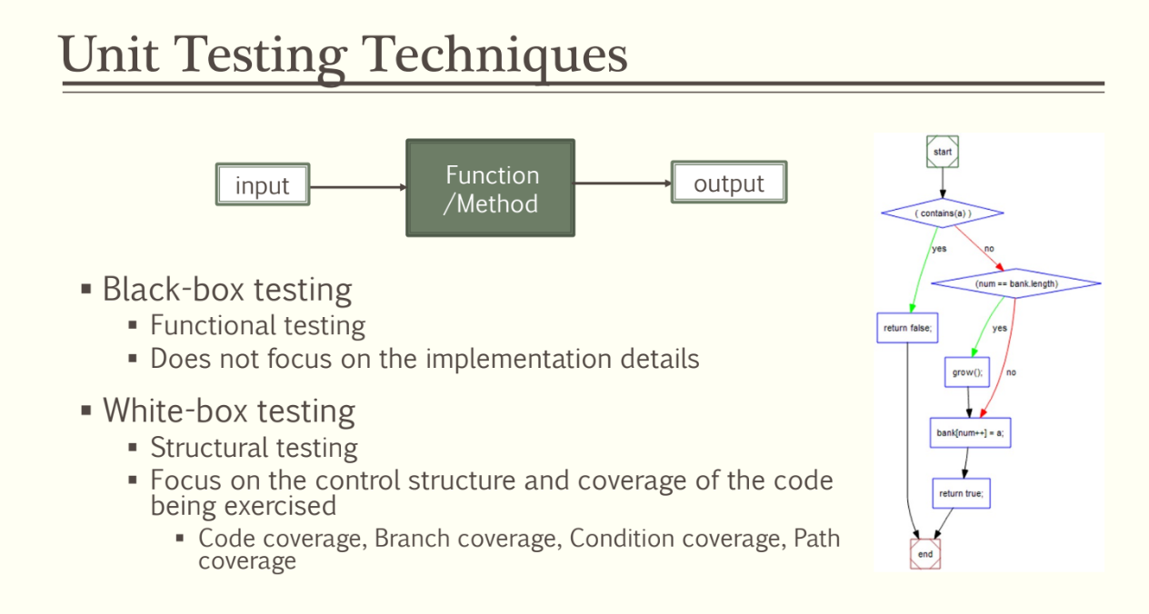
Notes:
There are two types of Unit Testing, Black-box testing and white-box testing.
Black-box testing doesn’t focus on the implementation details. The developer thinks about what can be the input of the method and what should be the output.
White-box testing focus on the control structure, such as the if-else statement, for loop, while loop. It also focus on the coverage of the code. Code coverage means that while executing the method on the test input, how many lines of code are actually executed.

Slide 6
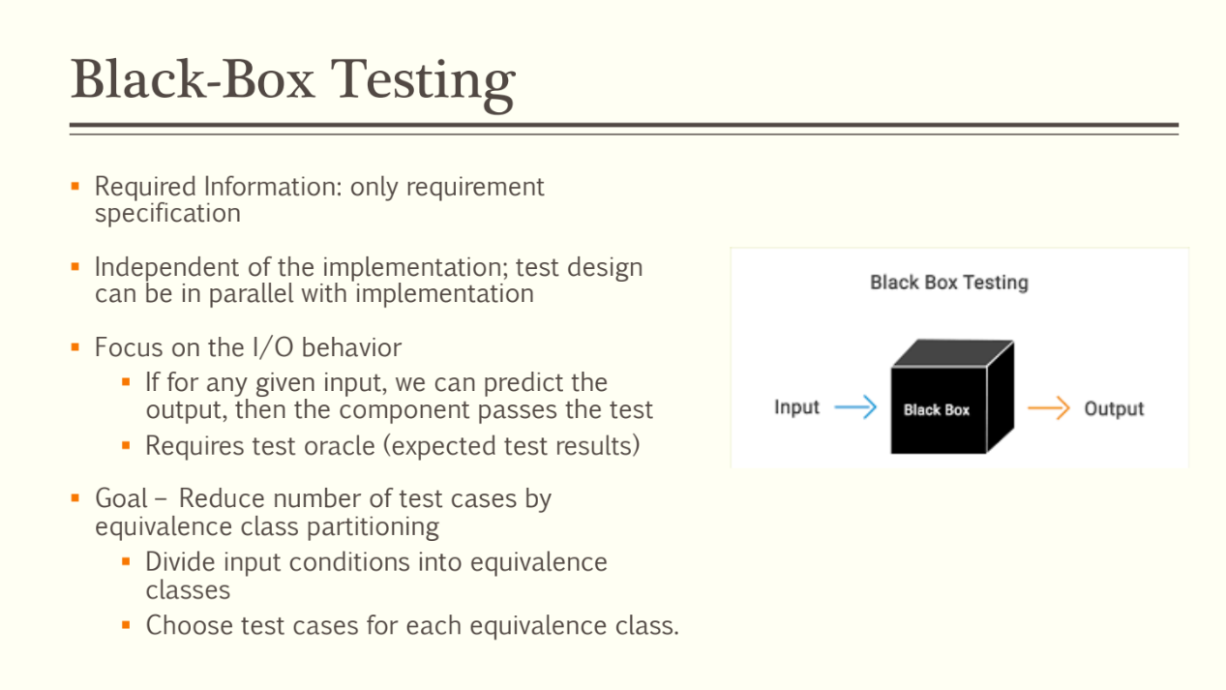
Notes:
The only required information of black-box testing is the requirement specification. What can be the input of the method and what should be the output. It’s independent of the implementation, so the test design can be in parallel with implementation.
Black-box testing focuses on the input/output behavior of the method. If for any given input, the component has the correct output, then the component passes the test.
The goal of black-box testing is to reduce number of test cases by equivalence class partitioning.

Slide 7
Black box testing example:
A simple login screen of software or a web application will be tested for seamless user login. The login screen has two fields, username and password as an input and the output will be to enable access to the system.
A black box testing will not consider the specifications of the code, and it will test the valid username and password to login to the right account.
This form of testing technique will check the input and output.
A user logged in when inputs a present username and correct password
A user receives an error message when enters username and incorrect password
The black box testing is also known as an opaque, closed box, function-centric testing. It emphasizes on the behavior of the software. Black box testing checks scenarios where the system can break.
For example, a user might enter the password in the wrong format, and a user might not receive an error message on entering an incorrect password.
Notes:
This is a black-box testing example.

Slide 8
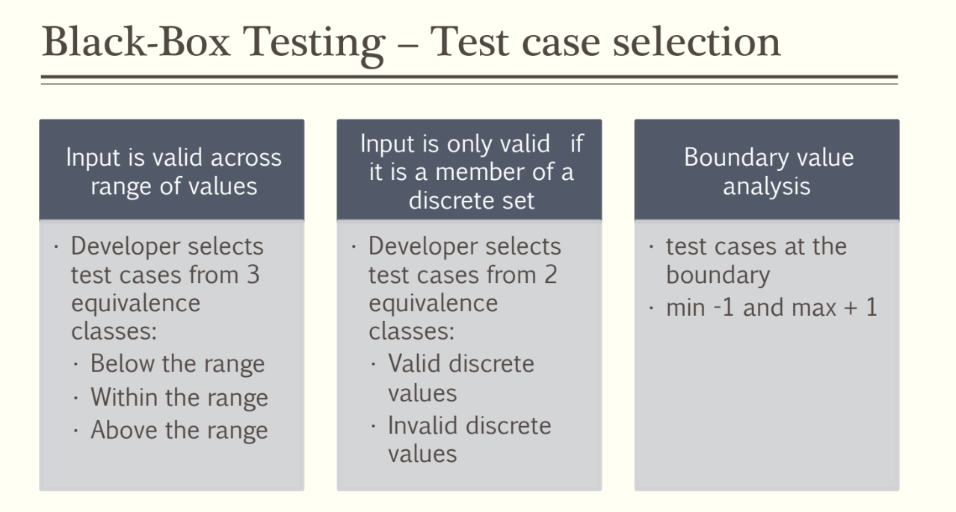
Notes:
This is about the test case selection of black-box testing.
In the situation that input is valid across range of values, developer selects test cases from thre equivalence classes: below the range, within the range and above the range.
In the situation that input is only valid if it is a member of a discrete set, developer selects test cases from 2 equivalence classes: valid discrete values and invalid discrete values.
We also should do boundary value analysis. Select test cases at the boundary.

Slide 9
Example 1
A software developer is designing software that allows automotive companies to record information about their individual customers. They were able to develop a field that allows users to input the age of a customer, with ages ranging from 18 to 65. The maximum value of the field is 65, while the minimum value is 18. Any values between 18 and 65 are valid values, while anything below the minimum or above the maximum is invalid. The developer then engages in testing to ensure that the values 17 and 66 are invalid, while 18 and 65 are valid.
Example 2
A printing company is responsible for producing and delivering printed copies ranging from one to 200. The company applies boundary testing by analyzing the extreme ends of the range. The maximum value equals 200, while the minimum value equals one. Therefore, the invalid values include zero and 201. The boundary value tests include testing to ensure that zero and 201 are both invalid and that one and 200 are both valid.
Notes:
These are two examples of boundary analysis.

Slide 10
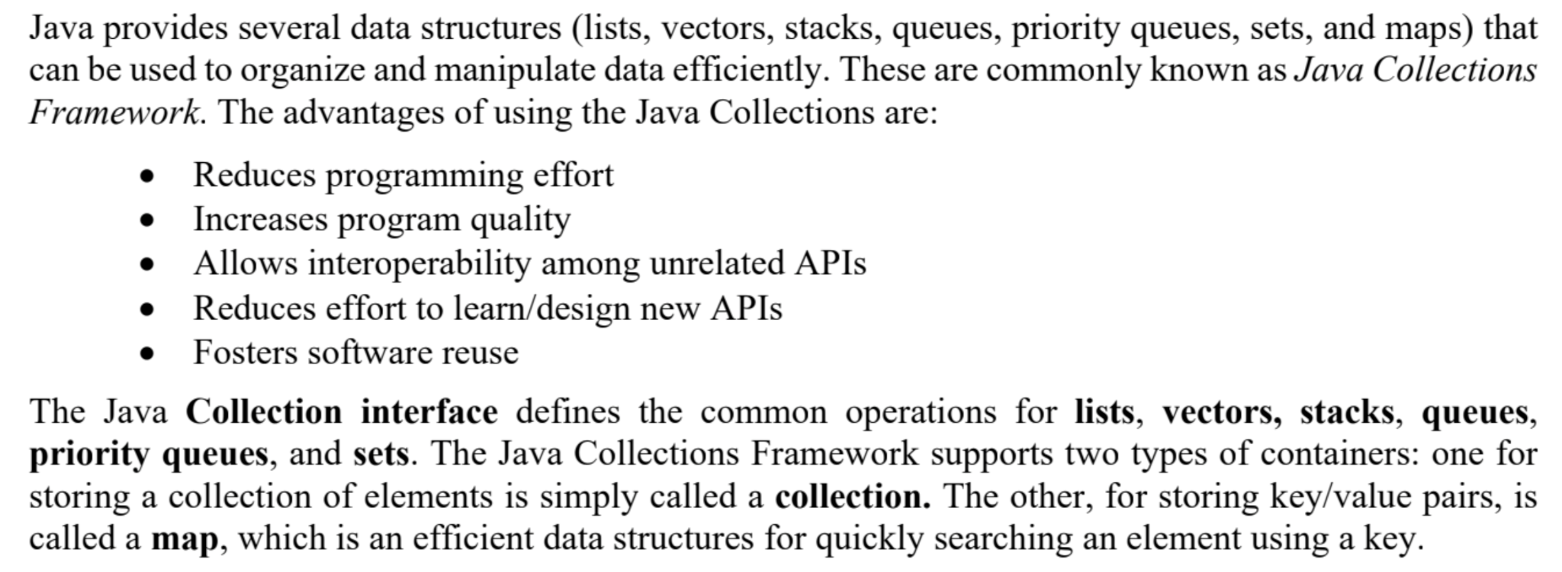
Java Collection
Notes:
Now, let’s talk about Java Collection.
(read slides)

Slide 11
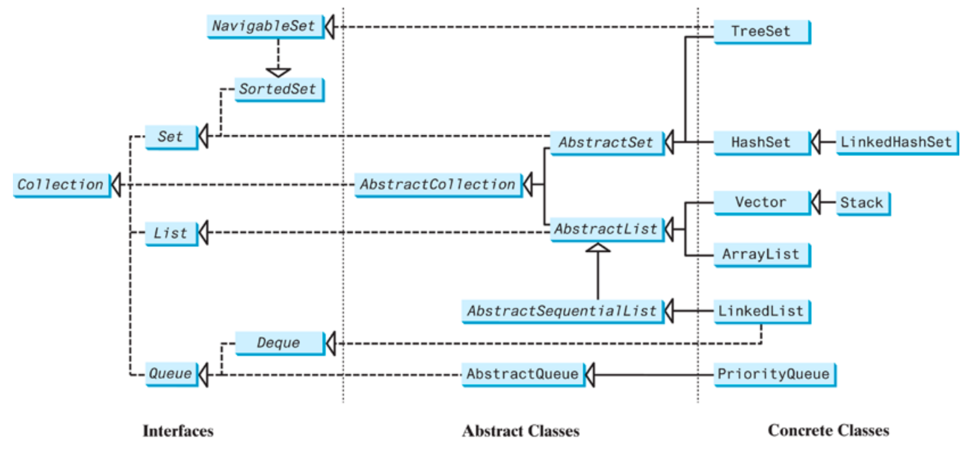
All the interfaces and classes defined in the Java Collections Framework are grouped in the java.util package. The design of the Java Collections Framework is an excellent example of using interfaces, abstract classes, and concrete classes.
Notes:
The interfaces define the common operations. The abstract classes provide partial implementation. The concrete classes implement the interfaces with concrete data structures. Providing an abstract class that partially implements an interface makes it convenient for the user to write the code. The user can simply define a concrete class that extends the abstract class rather than implementing all the methods in the interface. The abstract classes such as AbstractCollection are provided for convenience. For this reason, they are called convenience abstract classes

Slide 12
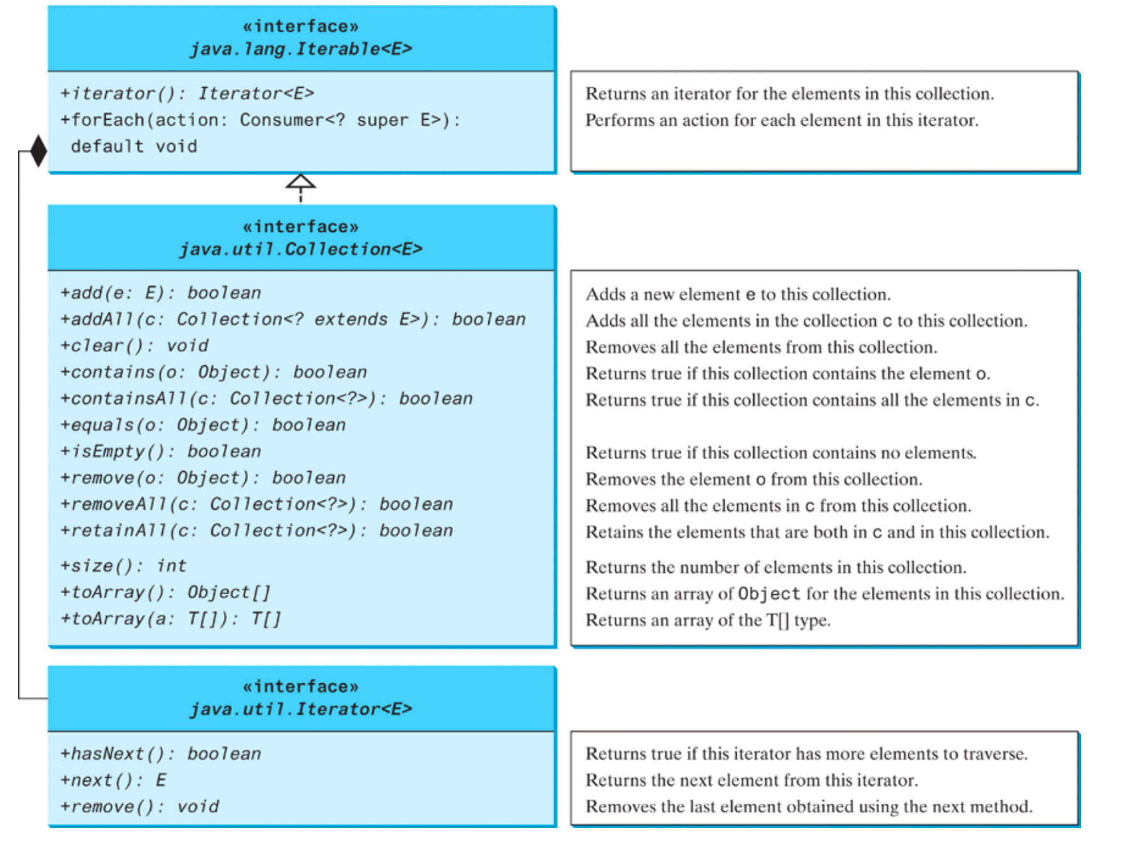
Notes:
The Collection interface is the root interface for manipulating a collection of objects. Its public methods are listed here.

Slide 13
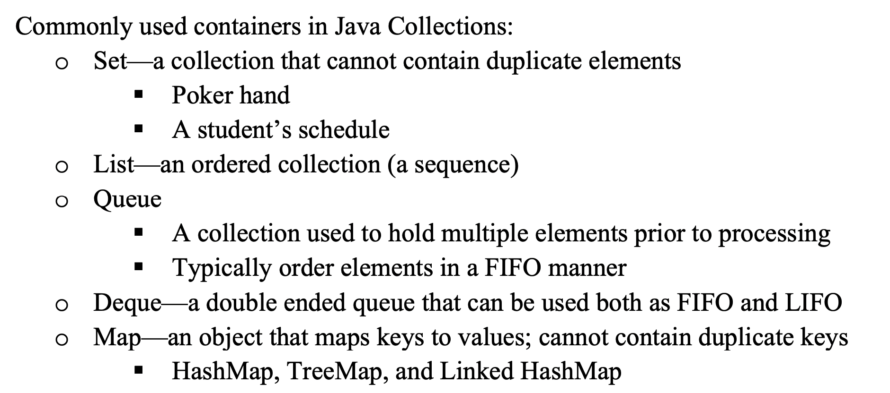
Notes:
These are commonly used containers in Java Collection.
Set is a collection taht cannot contain duplicate elements.
List is an ordered collection.
Queue is a collection used to hold multiple elements prior to processing. It typically orders elements in a First In First Output manner.
Deque is a double ended queue taht can be used both as First In First Out and Last In First Out.
Map is an object that maps keys to values and it cannot contain duplicate keys. Its subclasses include HashMap, TreeMap and Linked HashMap.

Slide 14
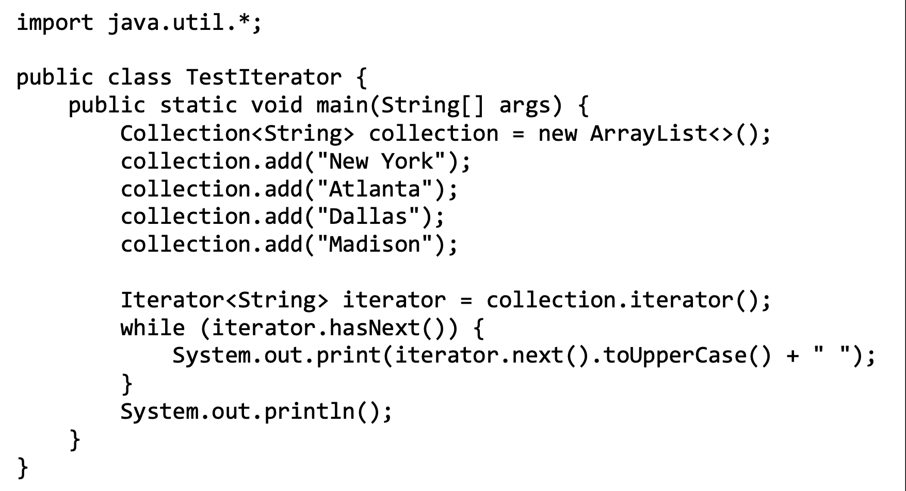
Each collection is Iterable. You can obtain its Iterator object to traverse all the elements in the collection. Iterator is a classic design pattern for walking through a data structure without having to expose the details of how data is organized in the data structure.
Notes:
(read slide)
This is an example about how to use the iterator object to traverse the collection.
The collection object here is an array list. It contains these strings. Here we get the iterator object of the collection object. Then traverse the collection and print the element.

Slide 15
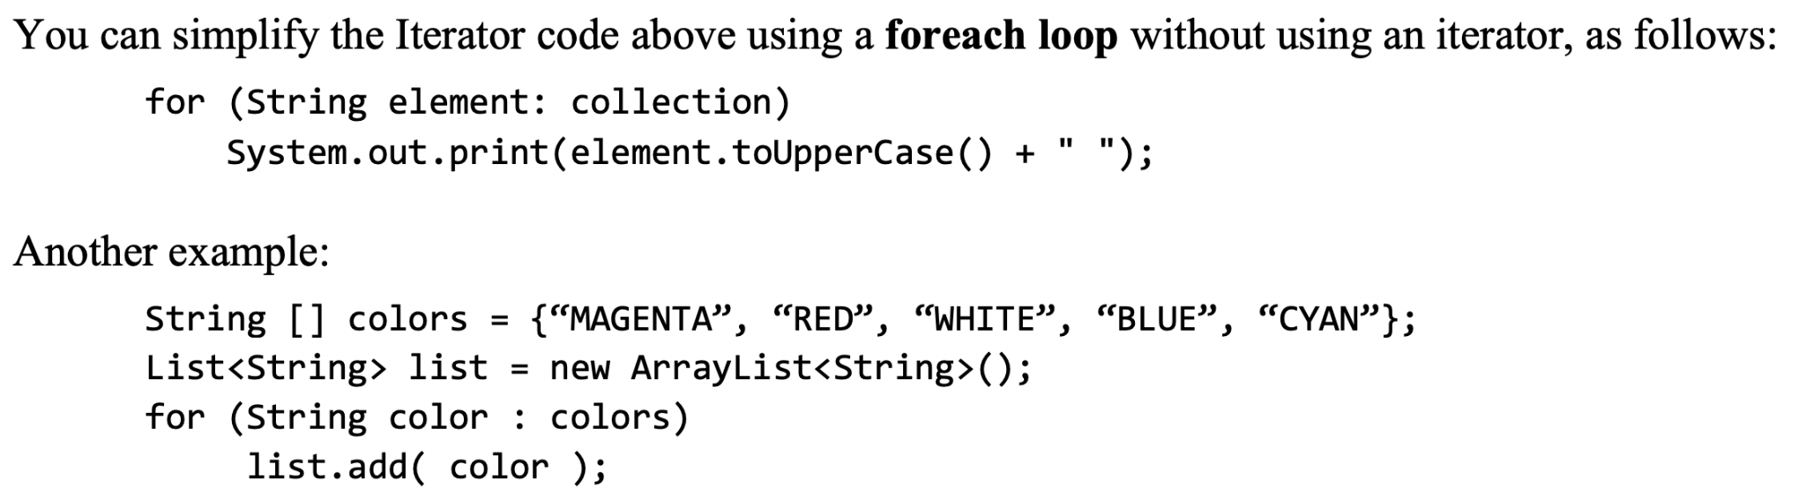
Notes:
You can simplify the Iterator code above using a foreach loop without using an iterator. Here is an example of the foreach loop.

Slide 16
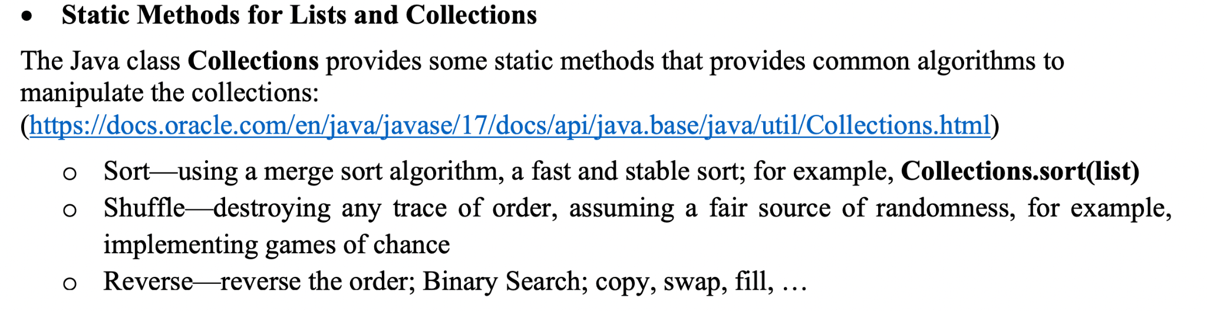
Notes:
The Java Collections class provides some static methods that provides common algorithms to manipulate the collection.
For example, the sort method uses the merge sort algorithm to sort the elements in a collection.
The shuffle method destroys any trace of order assuming a fair source of randomness.
The reverse method reverses the order of elements in a collection.
For details, you can read this website for details of these static methods.

Slide 17
Exercise
Notes:
That’s all for today. Thank you for coming.

Slide 18
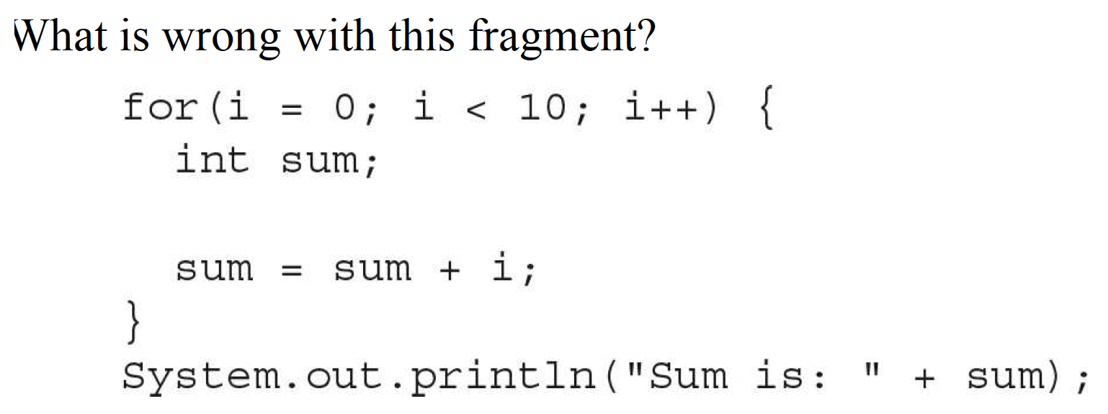
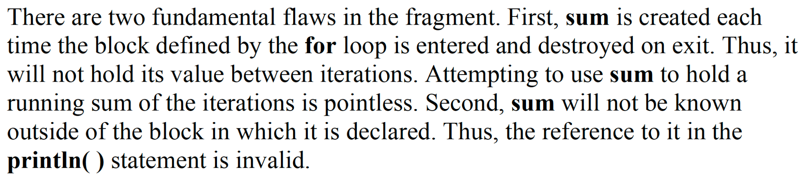
Notes:
That’s all for today. Thank you for coming.

Slide 19
Show two ways to declare a one-dimensional array of 12 doubles.
double x[] = new double[12];
double[] x = new double[12];

